Slide 1

Real-Estate Analysis
Nati Parnes
Idan Basil

Slide 2
The Research
Background
Around 20 years ago, every young couple would get married and most likely be looking for their future house.
Nowadays, the prices are so high that it is almost totally out of reach. What effect these changes? Can we predict which features will effect more than others?
Who doesn’t want to be able to predict the price of an house he is interested in buying?
Our Goal
Create a Machine Learning model that can predict an house price, based on a set of different features.

Slide 3
The Process
Scrape the web to get data about strains
Format, clean and complete missing data
Visualization of different aspects of the data
Create a ML model to predict housing price
Data Acquisition
Data Scrubbing
EDA
Machine Learning Modeling

Slide 4
Data Acquisition
Sources
We brought all of our data from the site : https://www.ad.co.il/nadlanprice
From “Strain of weed” we got the flavors
Tools
BeautifulSoup - a library that makes it easy to scrape information from web pages .
ask.
Data Acquisition
Data Scrubbing
EDA
Machine Learning Modeling

Slide 5
Data Acquisition – Process
Process
When we first tried to scrape data from “ad”. In order to acquire the data, we used a package called “BeutifulSoup”. We used a for loop to cover all the data (45,000 + pages)
The first crawl took ~15 hours, and actually failed towards the end. To successfully extract the data, we divided the “for” loop to 7 groups of around 6k pages. By doing so, we successfully scraped the whole data.
Using methods we learned at class we converted the seperated csv files into one big dataframe including all the entries.
Data Acquisition
Data Scrubbing
EDA
Machine Learning Modeling

Slide 6
Data Scrubbing
Remove all duplicates
Remove unnecessary columns
Remove columns with missing data that we cant complete.
Format the data from string to integers
Converting all float columns to int.
Changed columns names to English.
Data Acquisition
Data Scrubbing
EDA
Machine Learning Modeling

Slide 7
Data Scrubbing – Missing data filling
The idea behind our data filling was rational.
We investigated the data to better understand how we can handle the missing values.
i.e – “floor number” feature holds the number of floor for every entry, we figured that replacing these missing
values with the median (which came out to be 3~) is an acceptable solution while not harming the data integrity.
Data Acquisition
Data Scrubbing
EDA
Machine Learning Modeling

Slide 8
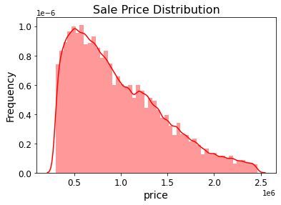
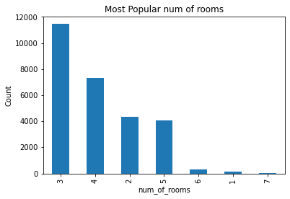
EDA – Real-Estate Data
Sale Price Distribution
Number of Rooms Distribution
Most of the deals between 1998-2021 is between 0.5-1.0M
The most selling apartment is between 3-5 bedrooms
Data Acquisition
Data Scrubbing
EDA
Machine Learning Modeling

Slide 9
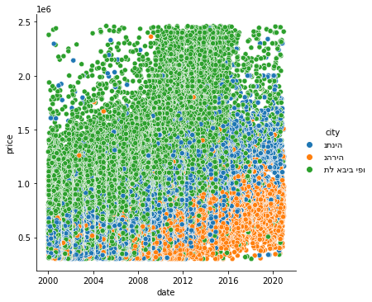
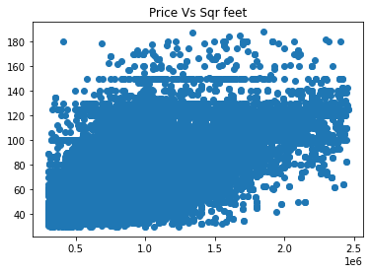
EDA – Real-Estate Data
Strain Types
The Pricing Radius from the center(Tel Aviv)
Price vs SquareFeet
After understanding the data we noticed that house prices always
go up, with a big factor to the price difference – The radius of the center.
The same happens for ”Top 3 Feelings”
As the squarefeet rises, less deals made
Data Acquisition
Data Scrubbing
EDA
Machine Learning Modeling

Slide 10
Machine Learning
The Goal
Create a model that can predict an house price by the features : “floor num”, “number of rooms”, “sqt”, “year”
The Method
We used ‘sklearn’ library and Linear Regression method to train the model and predict the house pricing.
The reason we chose Linear Regression is that our type of predicition is a pricing problem, and by using the train set we could predict the price.
Data Acquisition
Data Scrubbing
EDA
Machine Learning Modeling

Slide 11
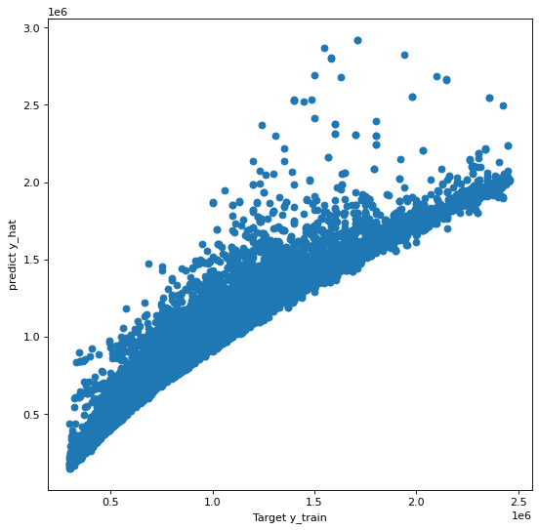
Machine Learning
Results
We tried different approaches to get the most accurate result.
Between ”No scaling”, ”Standard Scaling” and “MinMax Scaling” we found the difference in accuracy is minor.
Eventually, we decided to rely on R^2 Score which came out great! (91.4%).
We also used a visual “test” to better understand our model – using a scatter plot.
Data Acquisition
Data Scrubbing
EDA
Machine Learning Modeling

Slide 12
Conclusions
After investigating a big dataset (2.2M deals+) we realized it would be better go “drill down” into smaller one classified by the city.
The main conclusion we came up with is that house prices in Israel in the long run are always increasing no matter what. Most of the deals was in houses with 3-6 bedrooms and around 100 sqft.
Generally, in a “regular” year with no financial crises or wars or pandemic, the prices can go up by 7-10% a year, but when there is a year with some crisis of the above, the prices was stable or decrease by 2-3%.
We realized that the price go up in about 4%-5% average in a year, so go buy a house, it’s the best investment you can do !

